Slide 1

Notes:
Hi. My name is Amy Hodge, and I’m the science data librarian. Back in February, the President’s Office of Science and Technology Policy issued a memo that directs federal funding agencies to develop plans to support increased public access to the scientific publications and digital scientific data that are products of that funded research. I’m going to talk with you for just a couple of minutes about how research data management services can help you in a variety of ways, including meeting these new requirements. One service we provide is the Stanford Digital Repository, or SDR, which can preserve and share your digital research outputs, like...

Slide 2
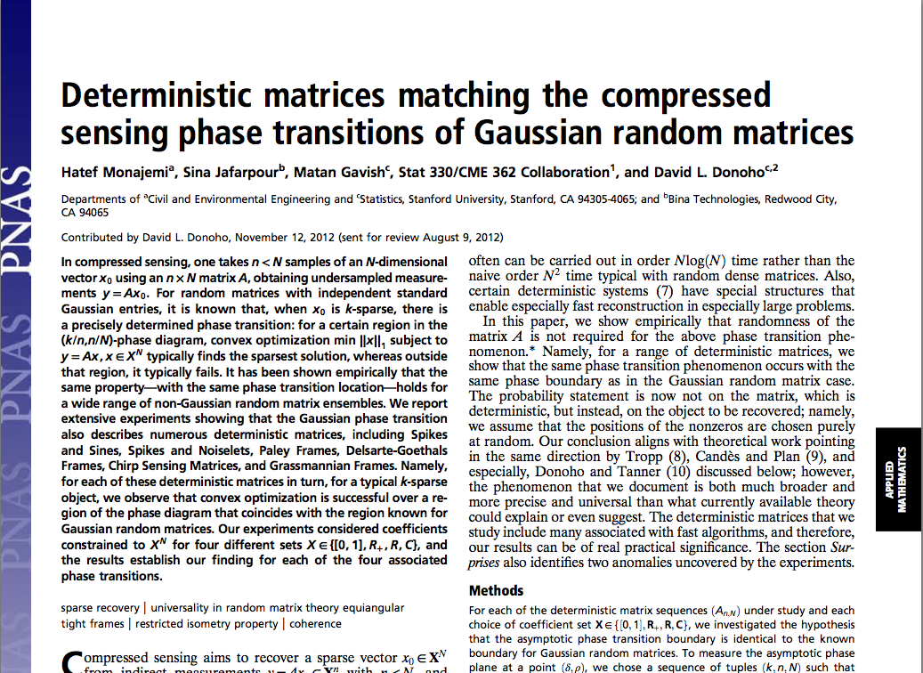
Notes:
...supplementary data for publications like this one in PNAS...

Slide 3
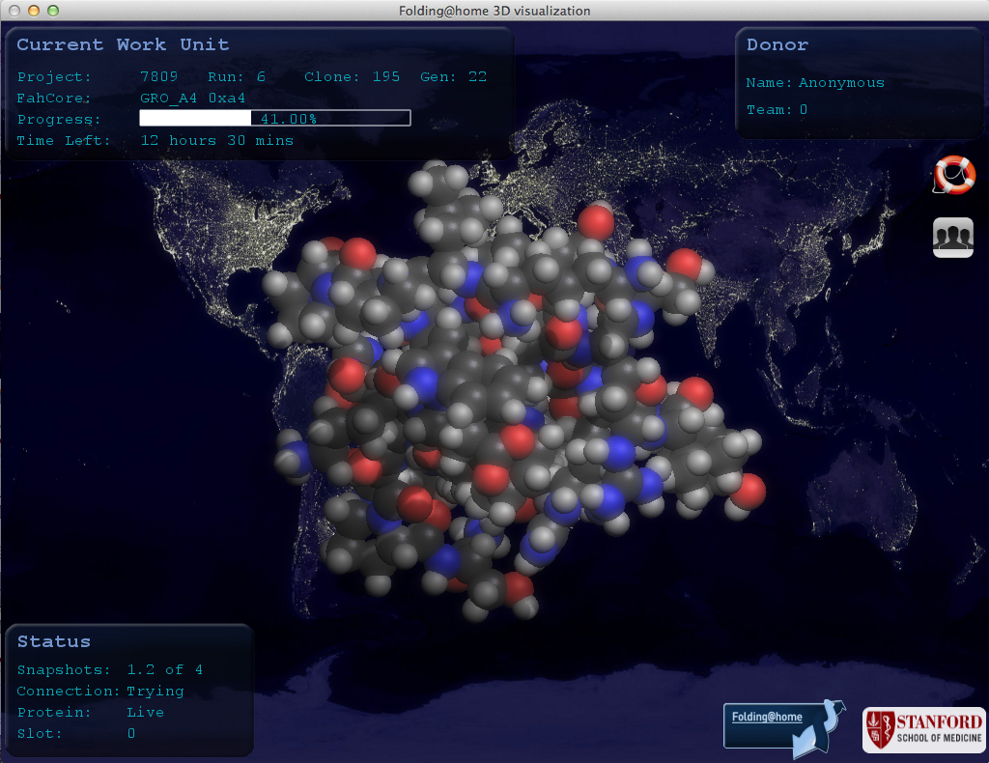
Notes:
...data sets collected over many years from long-running projects that you would like to share with colleagues around the world, like the data from the Folding@home project...

Slide 4
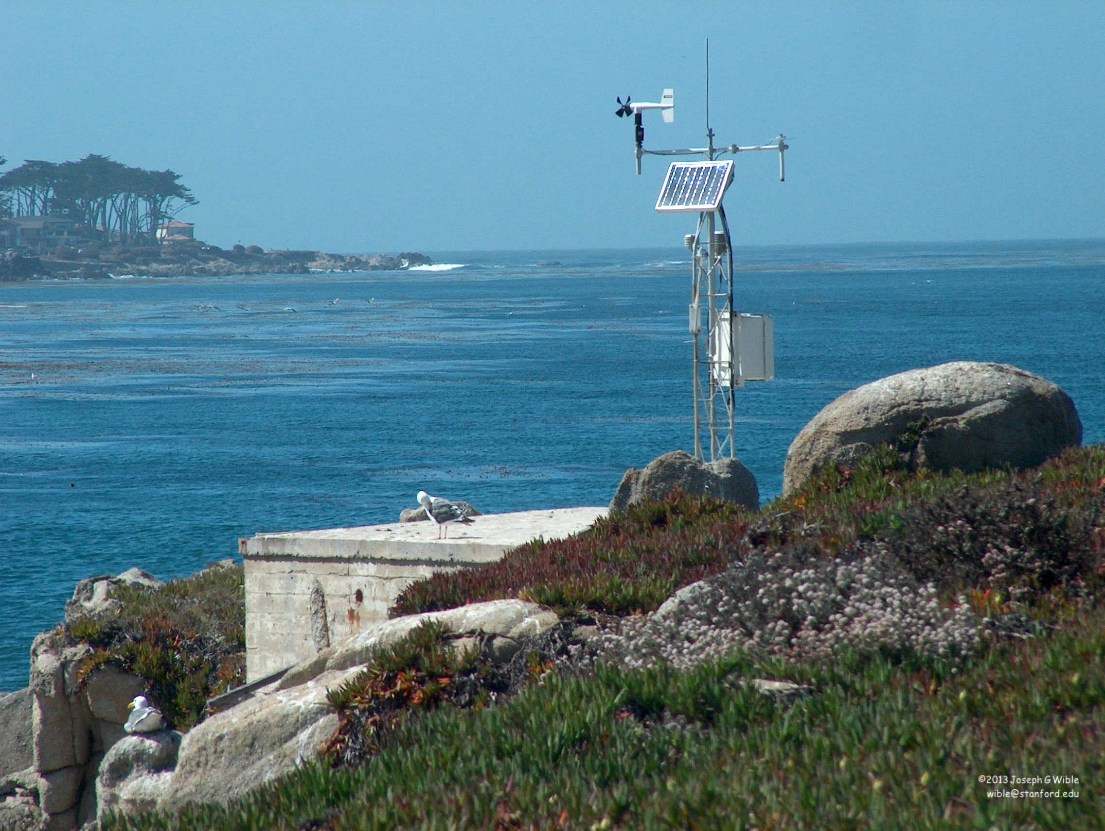
Notes:
..and data from long-term monitoring projects that include historical information that can not be reproduced, like projects at Hopkins Marine Station that monitor weather data...

Slide 5

Image by Mike Baird
Notes:
... and a variety of marine populations.

Slide 6
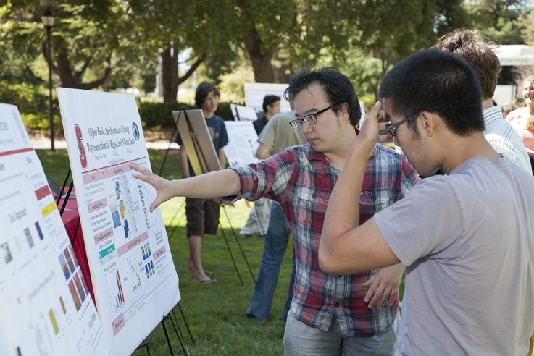
Image by Stanford Engineering, 2011
Notes:
The SDR can also be used to preserve and share things like your department’s undergraduate honors theses...

Slide 7

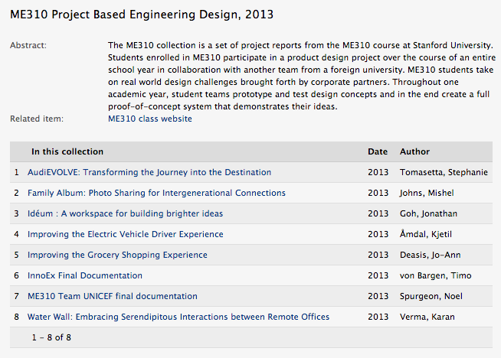
Notes:
... student projects from important courses...

Slide 8
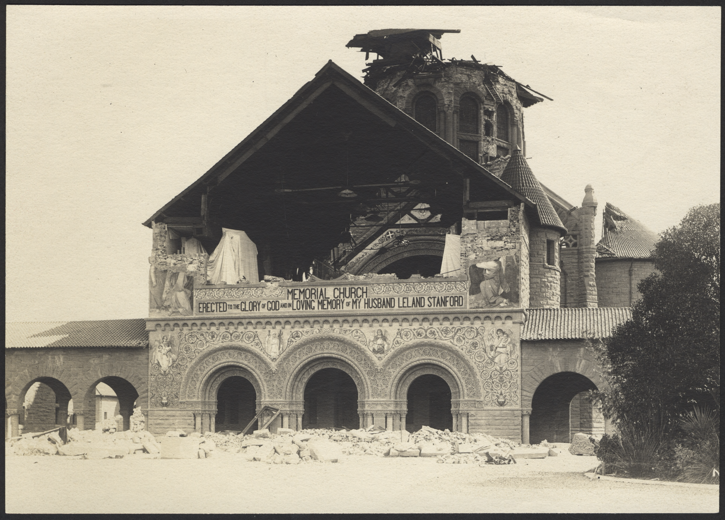
Image by Berton Crandall, 1906, courtesy of Stanford University Archives
Notes:
and technical reports, like the 170 or so tech reports from the John A. Blume Center for Earthquake Engineering that are currently being deposited.

Slide 9
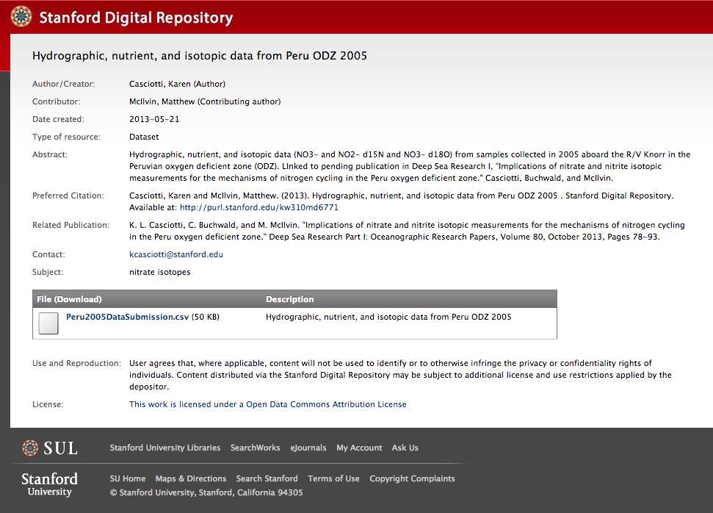
Notes:
When you deposit data into the SDR you get a persistent URL or PURL, at which that data can always be accessed.
Here's what a PURL page for a data deposit looks like. What you see here basically reflects the information that you are required to provide when you deposit data via our self-deposit web interface: authors, a description, how you would like these data to be cited, any associated publications, who to contact about the data, and any other related links. Then there is a list of files that can be downloaded with descriptions. You also have options to choose an embargo period, assign a license, and decide whether you want the PURL page to be visible to anyone in the world or just Stanford.
We consider this a lightweight approach to meeting NSF and other funding agency requirements for data sharing and preservation.
So, then, how do you get a PURL? It's very easy to do, takes just a few minutes, and three simple steps.

Slide 10

1. amyhodge@stanford.edu 2. sdr.stanford.edu 3.
Notes:
Step one. Email me. Access to the web-based self-deposit interface is via your SUNet ID, however, it is currently gated, so I need to specifically give you access.
Step two. Go to sdr.stanford.edu. Here you can create a new item, get your persistent URL, upload your files, and describe your data. You will also need to agree to the terms of deposit.
Step three. Publish. Easy as that.

Slide 11
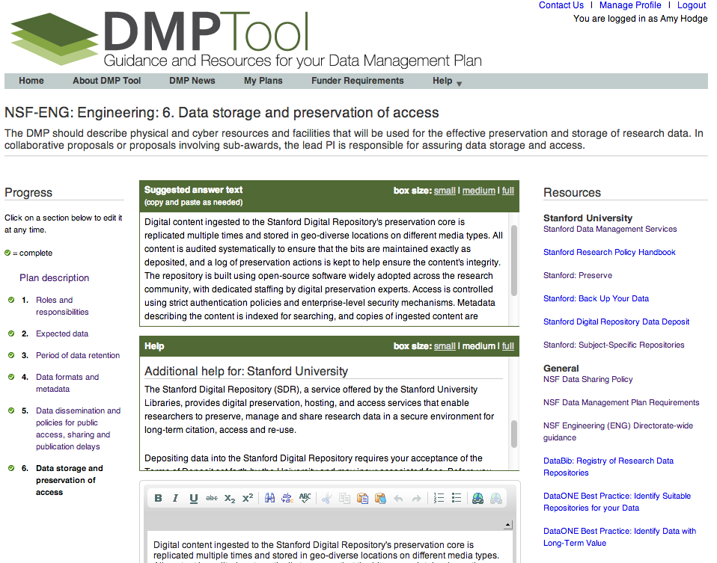
Notes:
Data Management Services also provides other tools and services, including access to the DMPTool, which provides assistance with writing data management plans for research grant proposals. When you log into this tool with your SUNet ID – which you can do right now – you will see resource links, help text, and suggested answer text that are specific to the Stanford community.

Slide 12
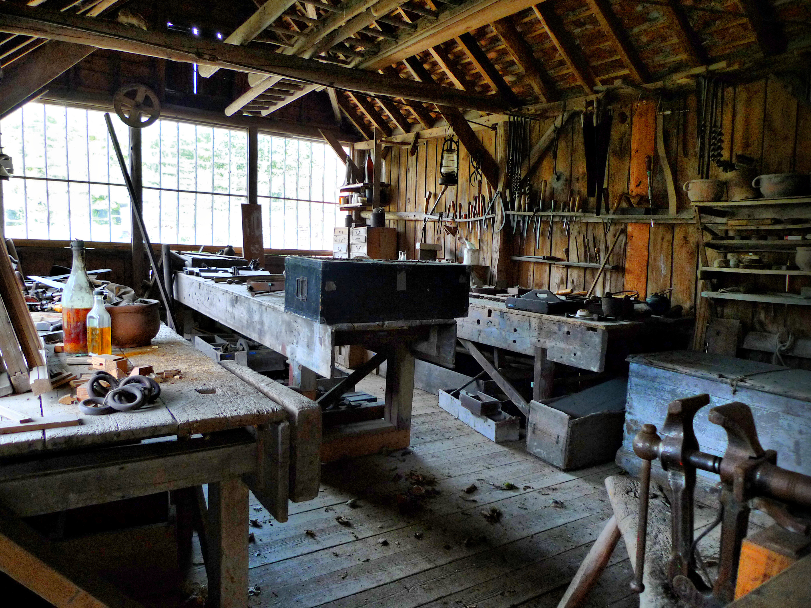
Image by Flickr user dweller88
Notes:
We also do workshops, including some this fall on best practices for your research data,...

Slide 13

Image by US Marine Corps
Notes:
...and we are also hosting a Software Carpentry boot camp in January targeted at experimental physics students. Software Carpentry’s goal is to help students become more productive scientists by teaching them basic computing skills like program design, version control, testing, task automation, documentation, and debugging.
That’s all I have. I want to thank you all for coming to Branner and helping us celebrate, blah, blah.

